Slide 1
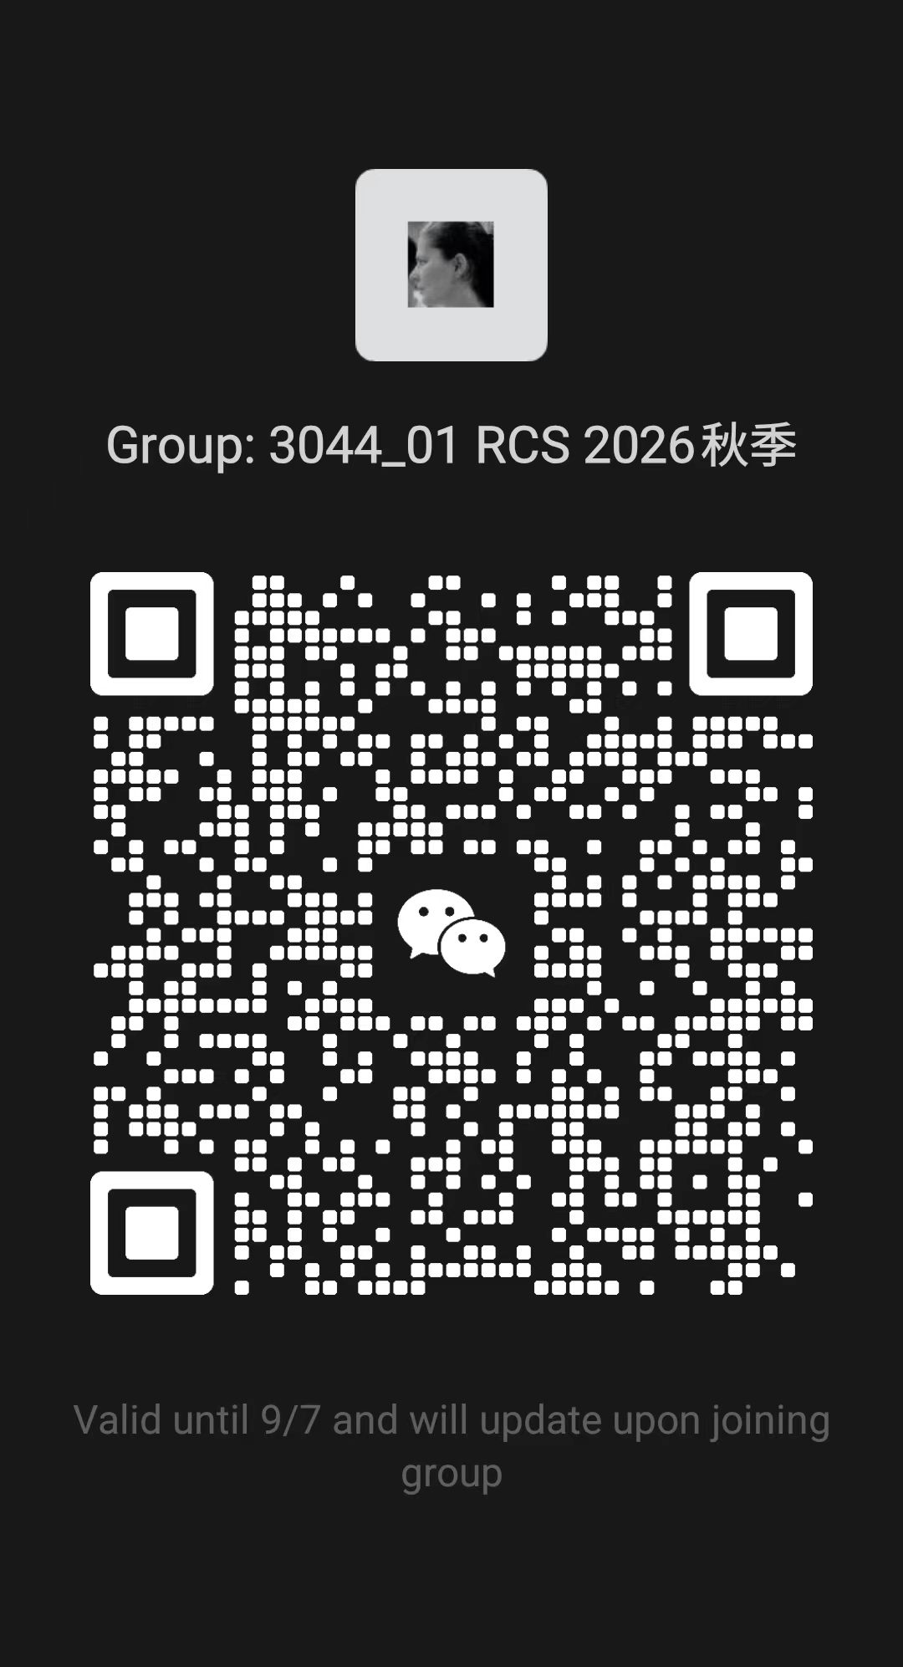
In the request message and in your WeChat name for this course group, please use both:
student ID number, and
your full name
Requests without this information will not be accepted

Slide 2

Research Communication Skills
In the request message and in your WeChat name for this course group, please use:
student ID number
your full name

Slide 3

Survey – 10 minutes
Please help me understand your plans and expectations for this course by answering the questions
  What are your expectations for this course?
  What is the one thing that you do want to do in this course and why?
  What is the one thing that you don‘t want to do in this course and why?
  What is your one question for me?

Slide 4

Contact information
Office: L1503
Office hours: by appointment
Lecturer: Dr Joanna Siebert
WeChat: JoannaSiebert

Slide 5





Slide 6
Attendance
http://is.hitsz.edu.cn/

Slide 7
Research Communication Skills
Course Design

Slide 8
Intended Learning Outcomes
By the end of this lesson you will be able to:
  Estimate your workload in this subject

Slide 9
Subject Objectives
Grasp the frontier of international research and have an international perspective
Engage in research
Detailed discussion of a specific research field and grasping its:
  status quo
  research progress
  research hotspots
Cultivate your academic research ability:
  reading scientific and technological documents
  writing research papers
  clearly expressing and reporting the content of research

Slide 10
Topics
Introduction to research
IoT Research Background
Reading research papers
Referencing and creating a reference list
Writing Related Work Section
How to write survey papers
Study of important papers
Designing academic posters
Writing research papers
Preparing for oral presentation
Peer review and paper revision
Common mistakes made by non-native speakers
Mini conference

Slide 11
Teaching plan: teaching activities
Participate in one project group, select your research topic and work on tasks:
  literature reading
  survey paper writing
  peer review
  research poster
  oral presentations

Slide 12
Materials
There is no textbook for this course
Web resources – you will be required to find online resources by yourself, including but not limited to journal and conference papers
Suggested reference books:
  侯进. 计算机专业英语—科技交流与科技论文写作. 电子工业出版社，2016.
  王慧莉, 刘文宇, 高桂珍, 曹硕. 任务型学术写作. 中国人民大学出版社，2014.
  任胜利, 莫京, 安瑞, 刘徽. 科技写作与交流—期刊论文、基金申请书及会议讲演. 科学出版社, 2017.
  Strunk, William. The elements of style. Penguin, 2007.
  Academic Essay Writing for Postgraduates. English Language Teaching Centre, University of Edinburgh, 2014.

Slide 13
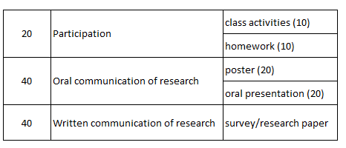
Assessment

Slide 14
Group project schedule (tentative)
Do presentations in class
  Poster presentation
      Submit your poster – October 14th
      Presentation - October 19th - (poster design + presentation)
  Oral presentation
    Presentation in class - October 26th and October 29th (PPT design + presentation)
    Submit your PPT – October 29th
Paper writing
  Submit your survey paper draft – October 14th
  Submit your final paper – October 22nd
  Participate in a peer review session
    Submit the peer-review of another group’s survey (individual work - Homework 6) – October 27th
    Submit the revised version of your paper with a response letter to the reviewers and a contribution table (group work) – November 5th

Slide 15
Tools we will use in this subject
Lecture materials
  WeChat course group
Submission of assignments
  WeChat – privately, directly to me
  WeChat project groups

Slide 16
Please contact me
if you have any concerns about this subject or require special assistance:
  approach me after the lecture
contact me on WeChat
or schedule a meeting in my office

